Slide 1
Guide.
www.etuinteriors.com
a peek at what's new and noteworthy
Winter 2024 / 25

Slide 2
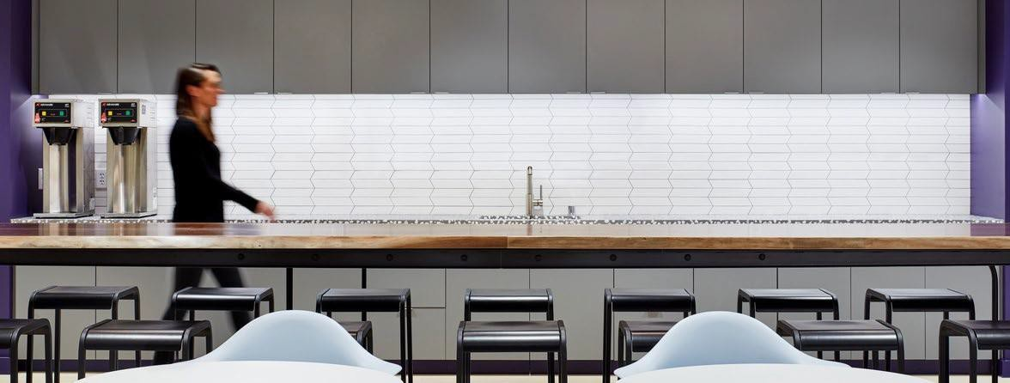
Perhaps you are searching for fresh inspiration.
Maybe you need a glimpse of what's new. Solutions seekers ideally it will help you too.
It is our humble hope that you will all enjoy this little seasonal product guide featuring e tu partners.
Why Guide.

Slide 3
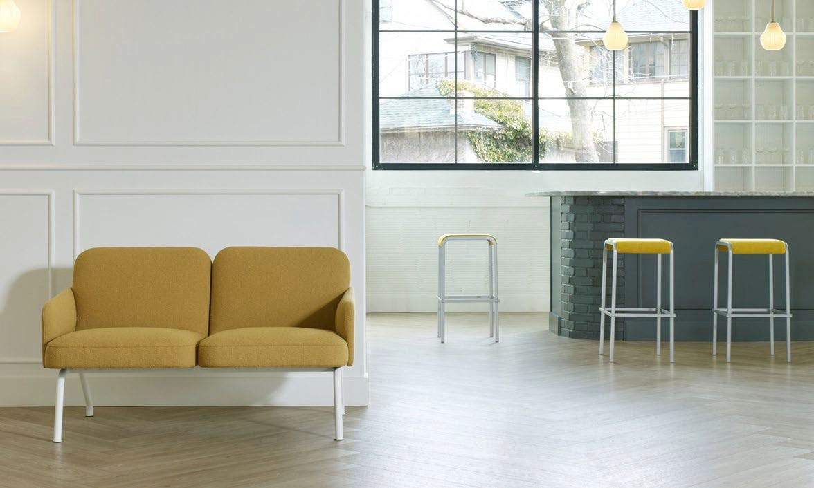
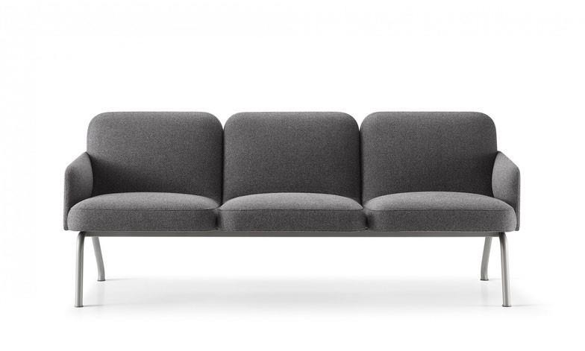
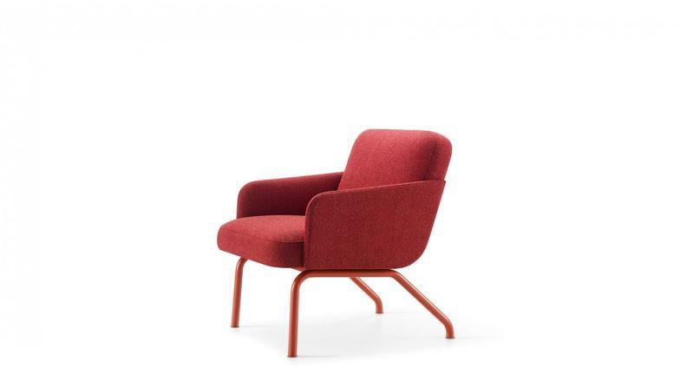
Nordic.
N E W
Designed by Norwegian Bery & Hindenes, the Nordic lounge was crafted with distinct character. The seat and back are constructed of high resiliency molded foam with the addition of flexible webbing for suspension and comfort. The frame and legs are fabricated in high-strength low-alloy steel for the highest level of durability.
Nordic's inviting style and robust constructions makes it ideal for lively hospitality spaces, corporate collaboration and high traffic public amenity spaces.
Shown with the Viiva Stool by Source International Design

Slide 4
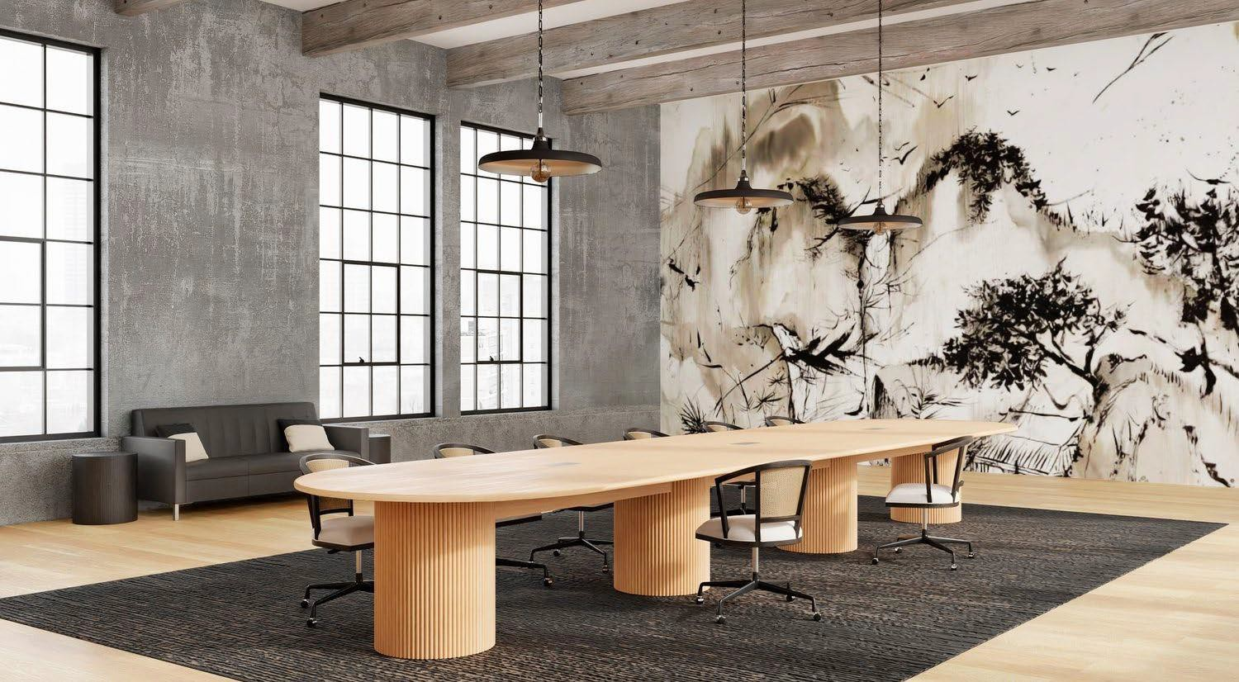
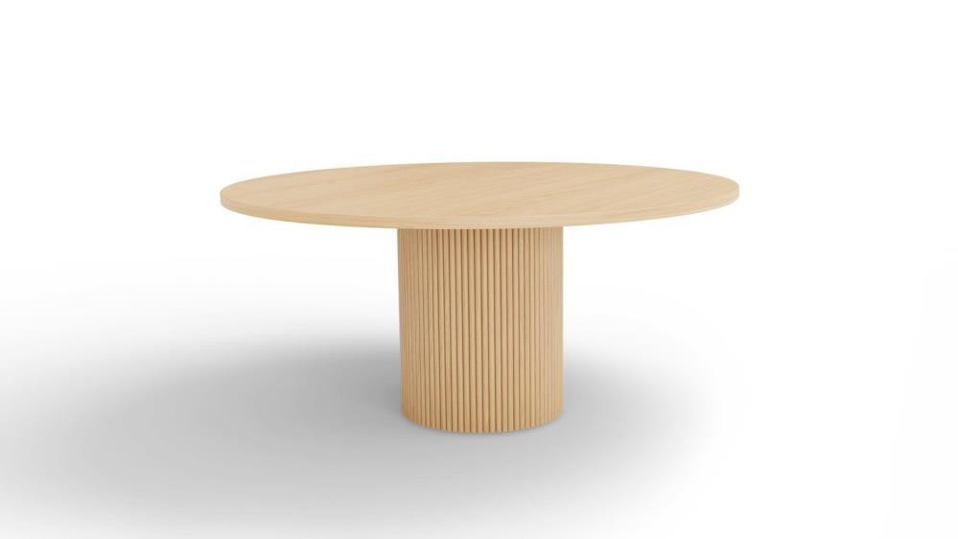
01
Coriander Designs is an innovative domestic wood furniture manufacturer with unique Northwest Urban Design Aesthetic..
02
03
Coriander Designs is a WBE Certified Woman Owned Business headed by second generation
owner, Carly Boudreau”
.
Sister Company Meyer Wells: “We are passionate about responsibly-sourced wood and the amazing works of art we can create with one
of nature’s greatest gifts”.
.
Reed.
Coriander Designs.

Slide 5
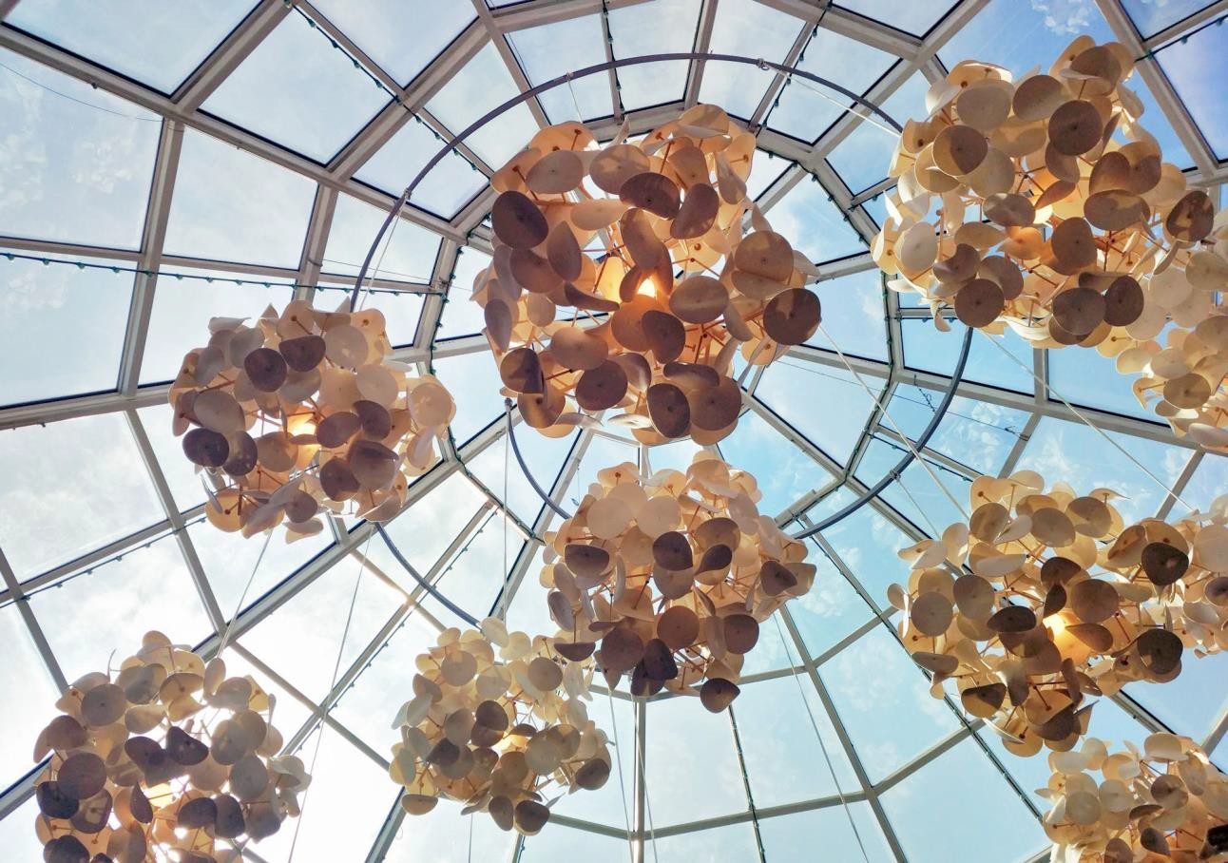
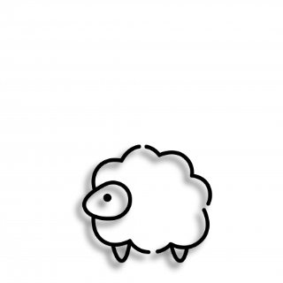
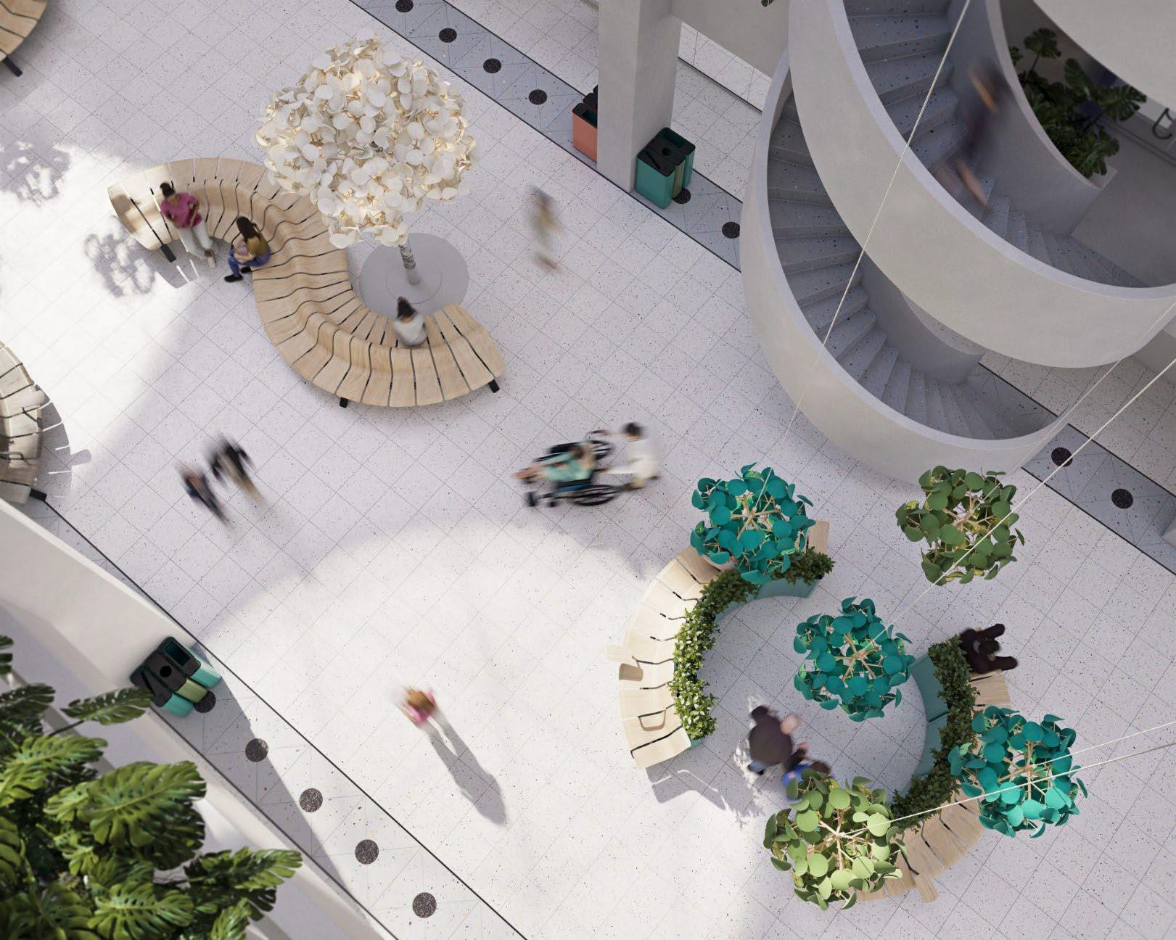
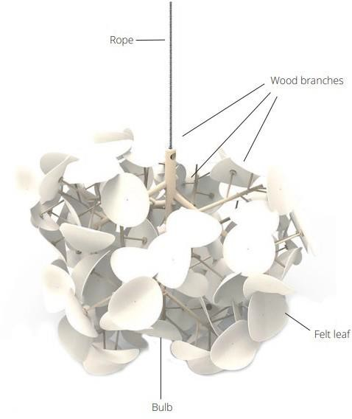
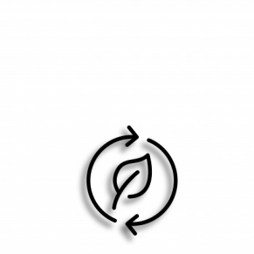
Fresh take…
Biophilia.
100% certified sourced, untreated birch wood from responsible forestry
Certified Oeko-tex
standard 100 wool felt
Metal parts: powder coating with zero chemicals on the SIN-list
The branchwork is clicked together without the use of any adhesive.
Leaf Lamp Series | Green Furniture Concept
Each part can be replaced individually for easy maintenance during the product’s life cycle.
At the end of the product’s lifecycle, all parts can be separated to material level and recycled
“One of the great challenges of our time is to bring the beneficial experience of nature into the design of contemporary buildings, landscapes, communities, and cities.” – Stephen R. Kellert, Nature by Design: The Practice of Biophilic Design

Slide 6
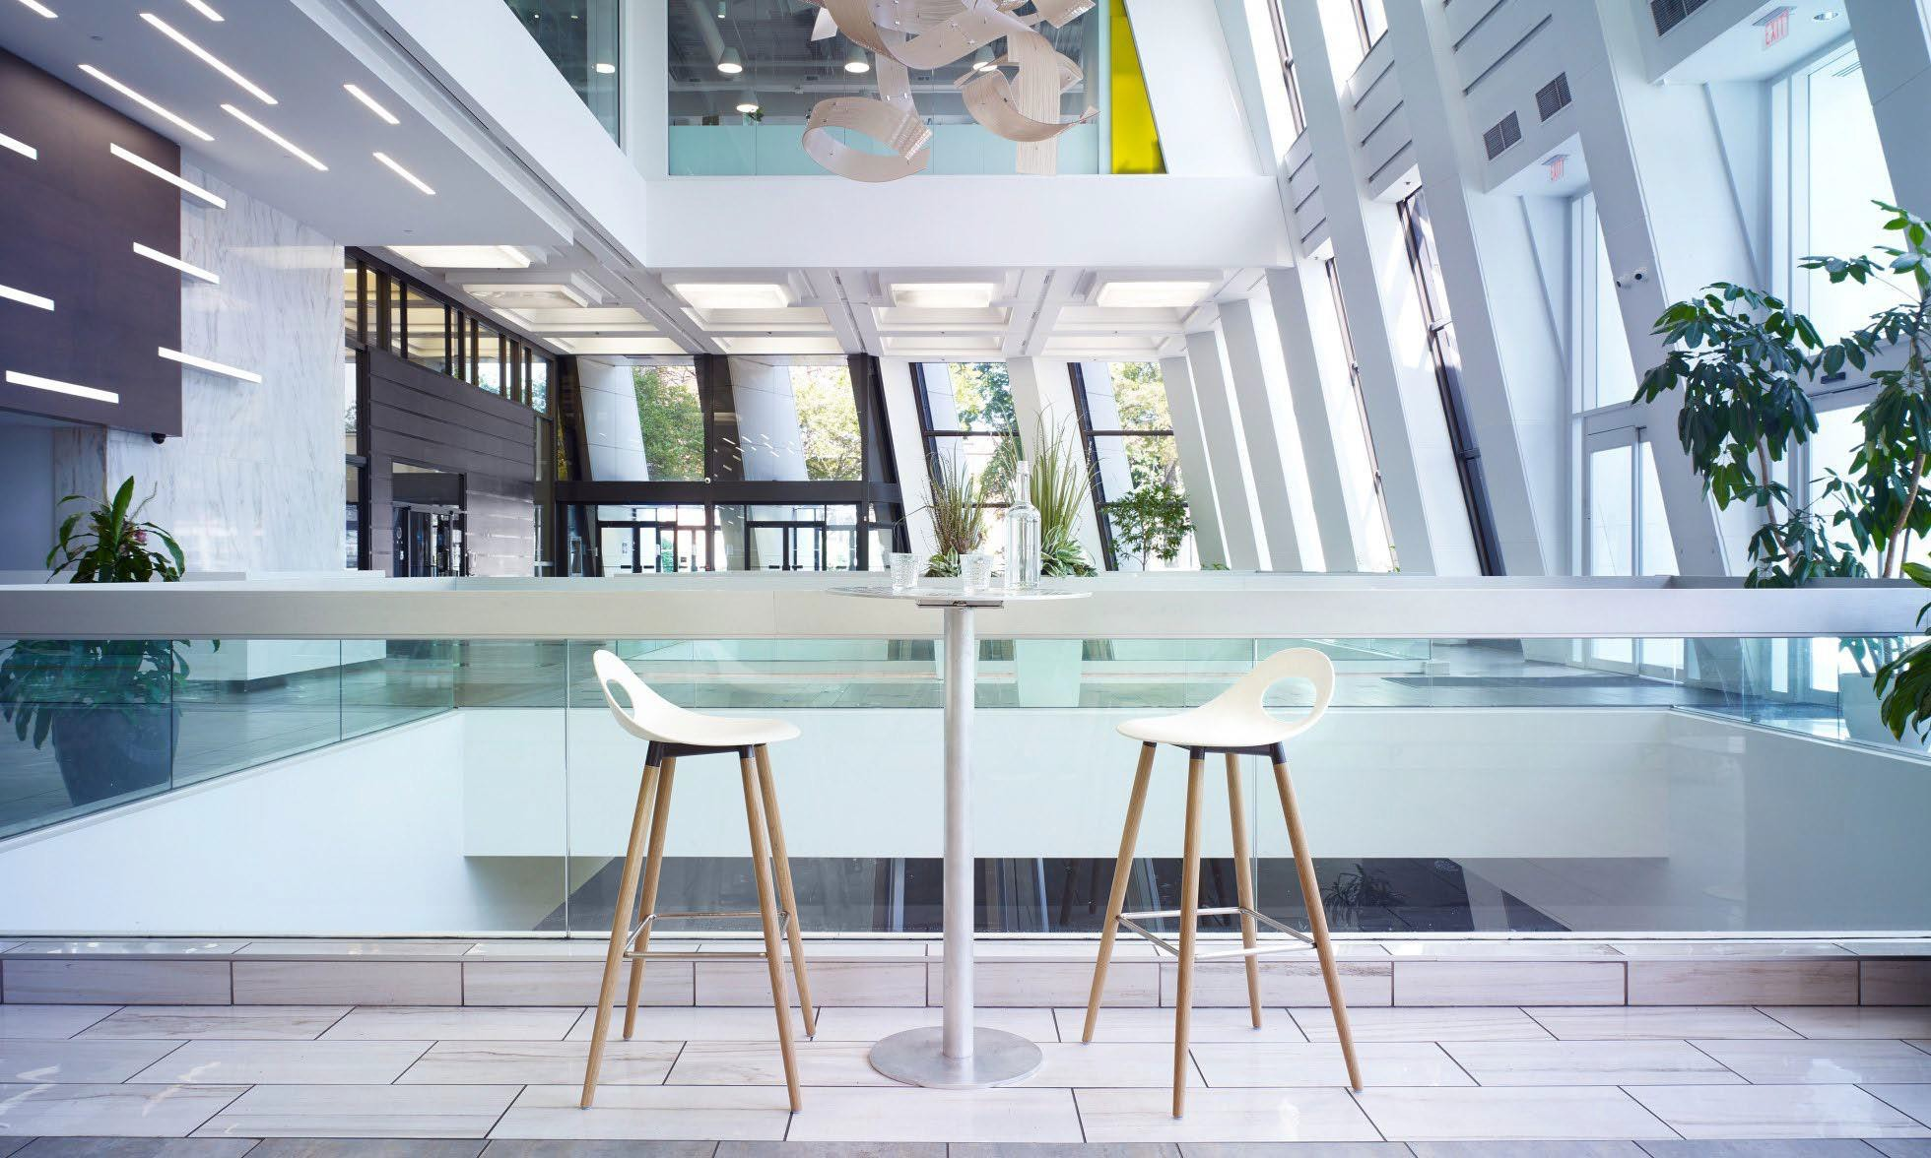
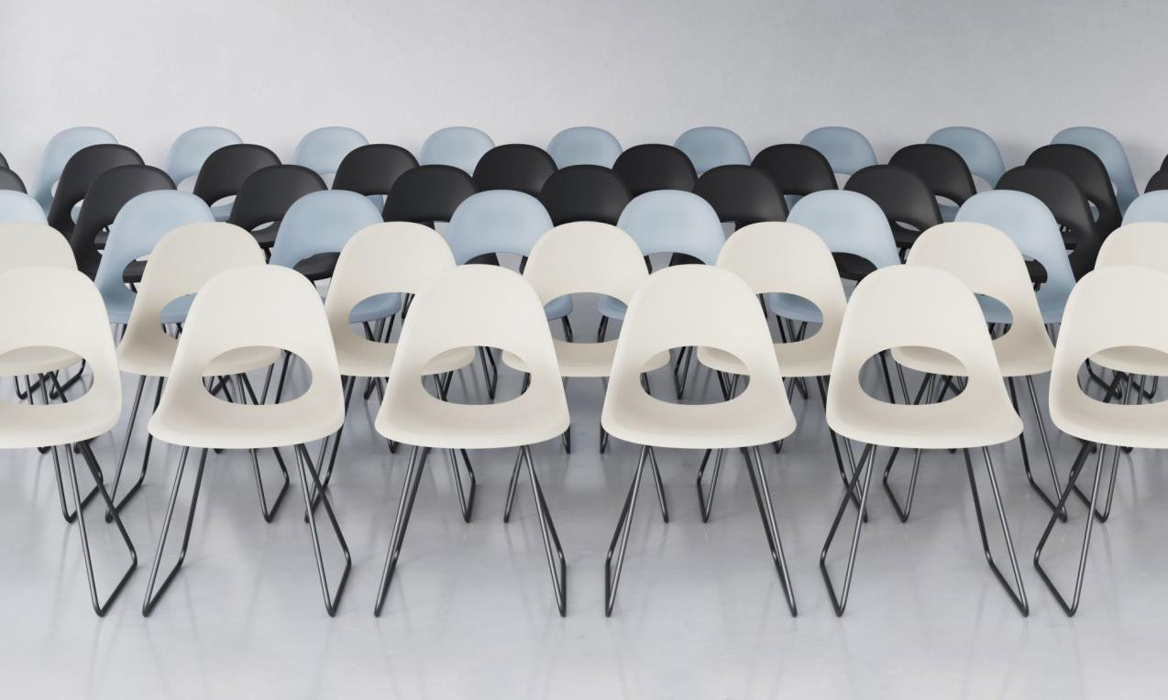
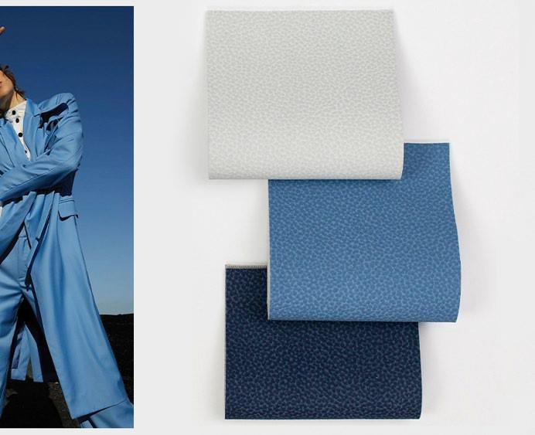
Clean.
Clean Lines:
Simple classic design aesthetics are trending.
Clean = clutter free Scandinavian Design principals hard at work.
Cleanable:
While the world has seemed to right itself, keeping our
spaces safe and germ free is still a priority.
Introducing Say O poly collection by Source International Design.
Reef Pro by Ultrafabrics, Ink and Stain resistant and bleach cleanable

Slide 7
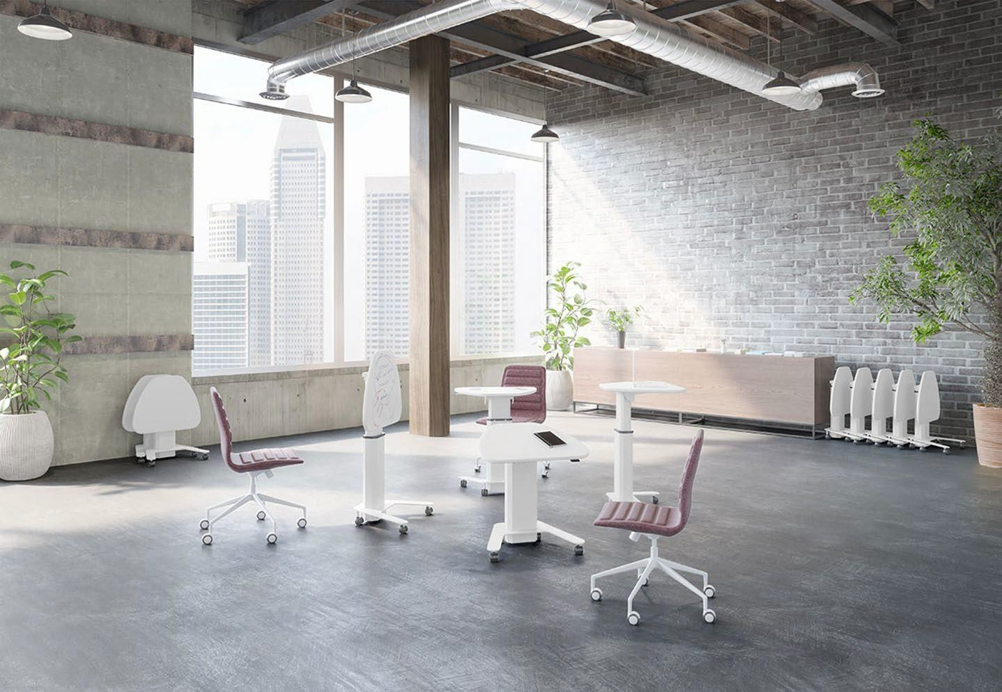
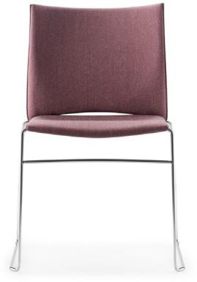
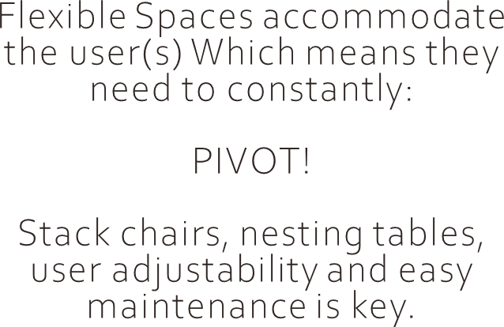
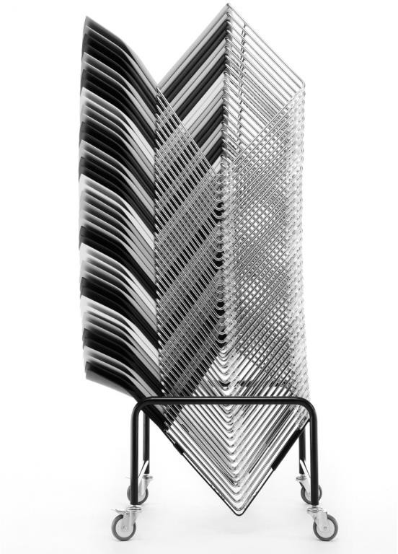
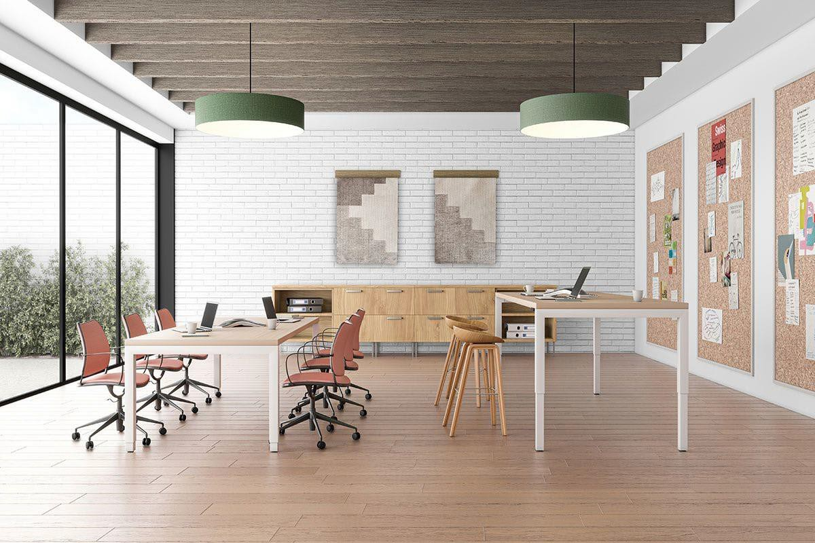
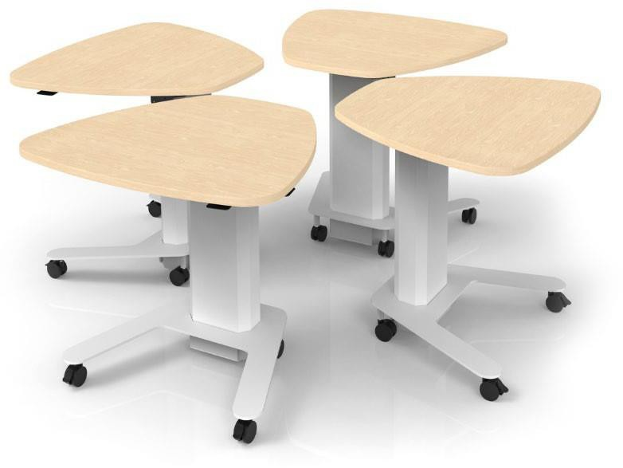
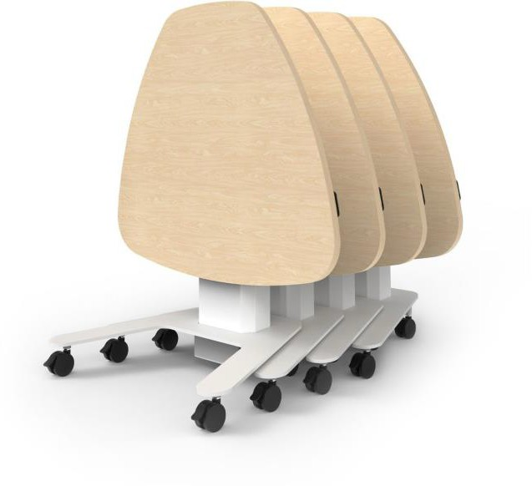
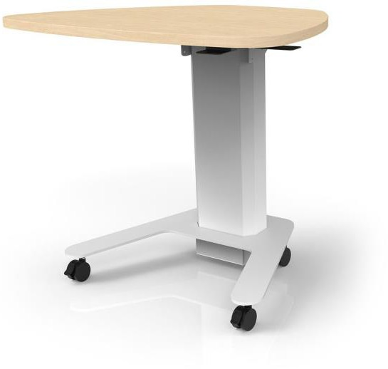
Flexible.
Tier Stacking Chair
M Nesting Height Adjustable
Ellehaven Height Adjustable

Slide 8
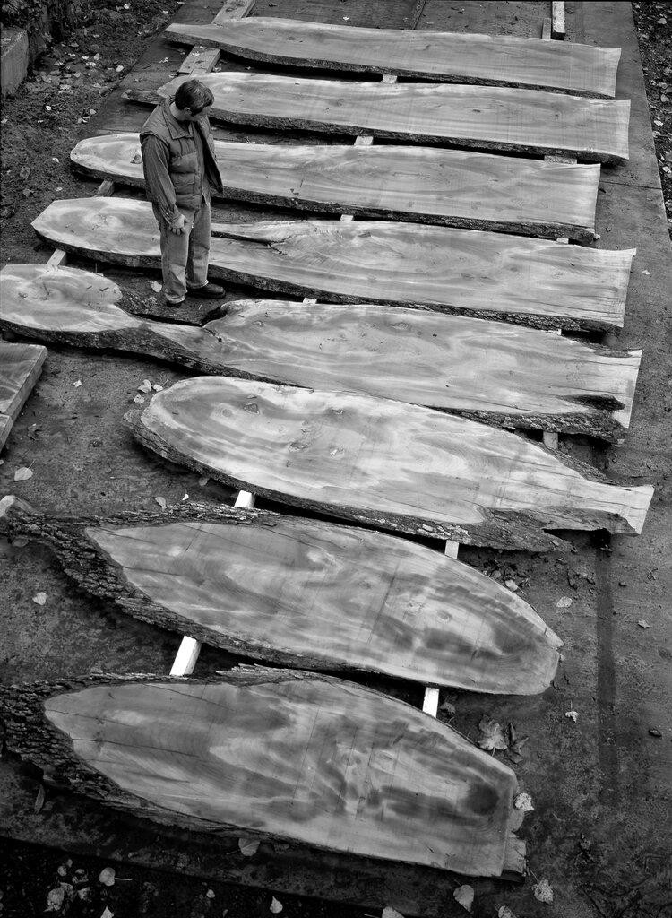
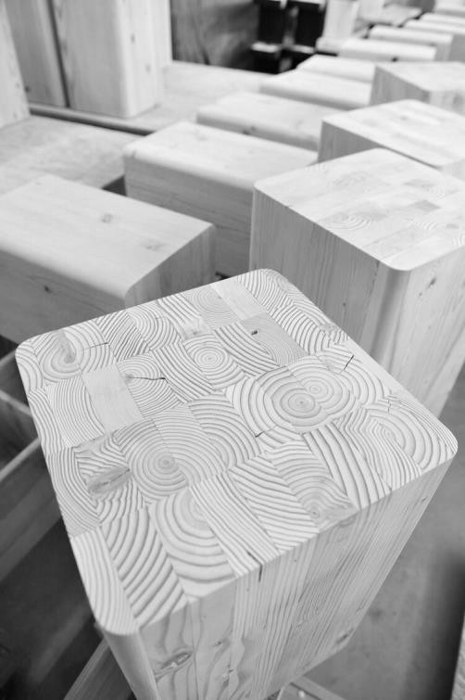
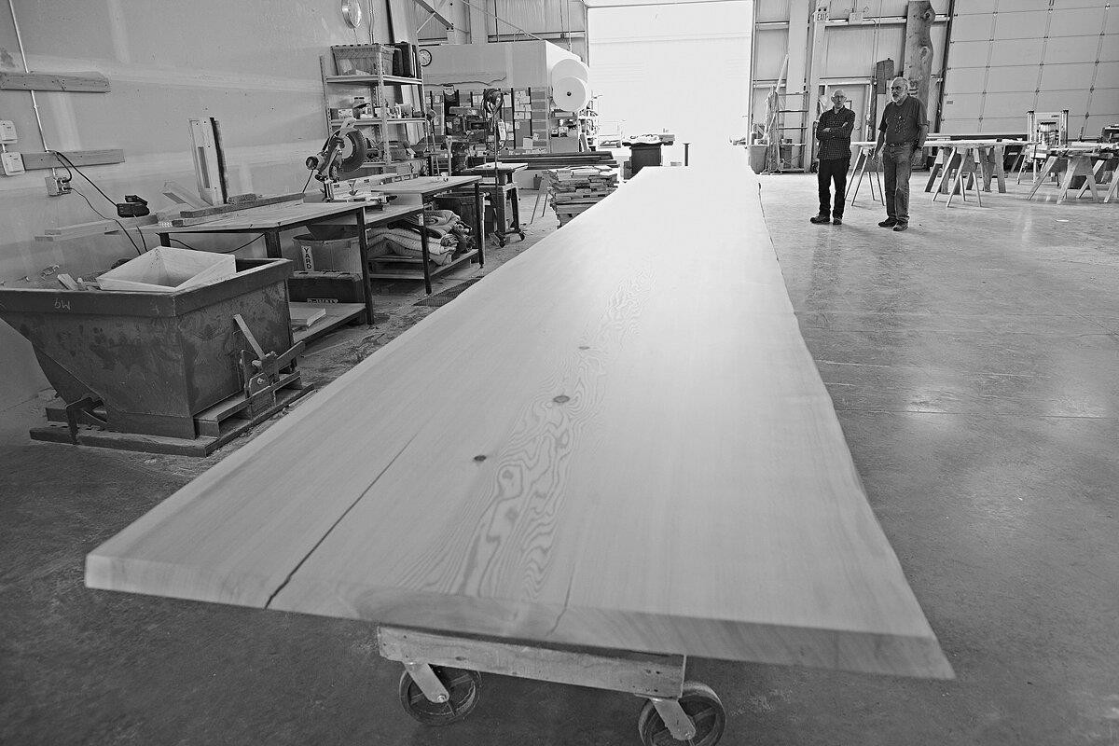
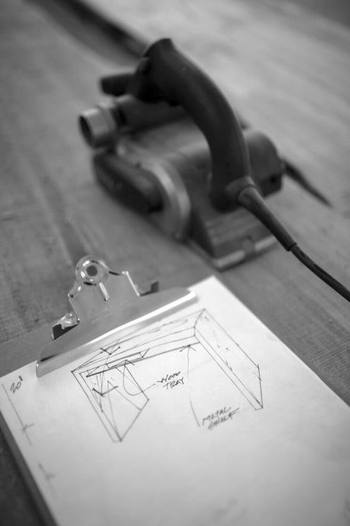
Wood is Art.
custom community tables
Learn the differences between wood slabs and multiplank
“The physiological and psychological benefits of being in a space with wood are many: lowered blood pressure and heart rate, perception of warmth, and connection to living things to name a few. In addition, research continues to indicate that nature-made and human-made environments are processed differently in our brains, influencing which is the preferred experience.”
Biophilic response to Wood | Arch Daily

Slide 9
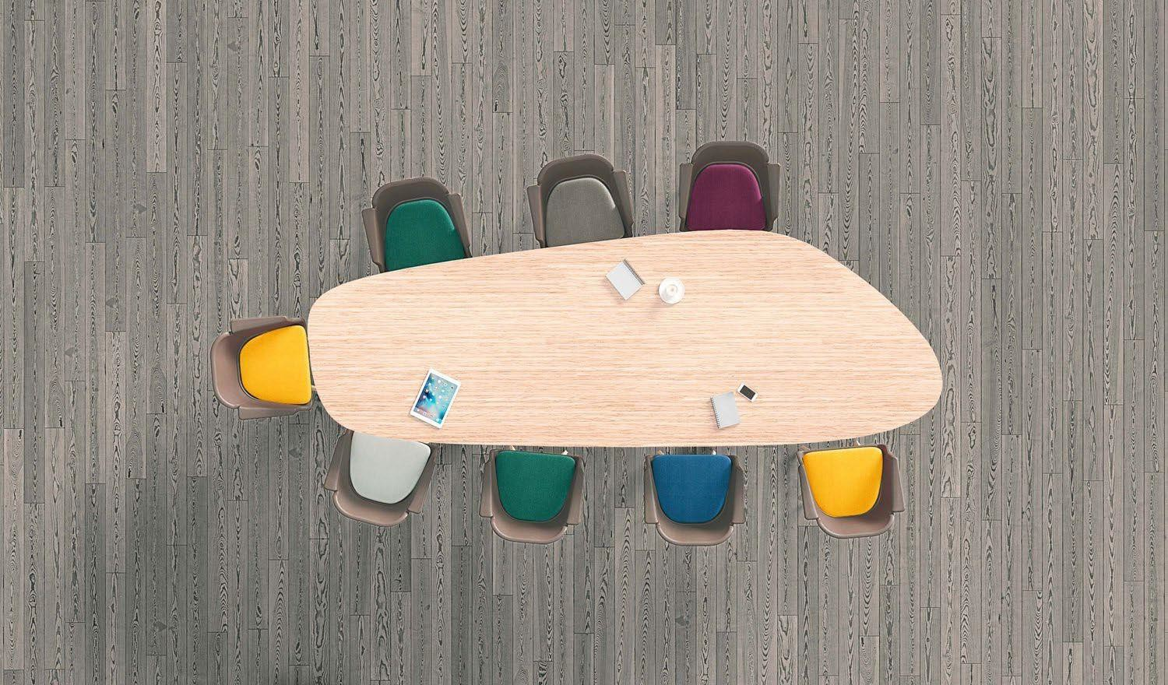
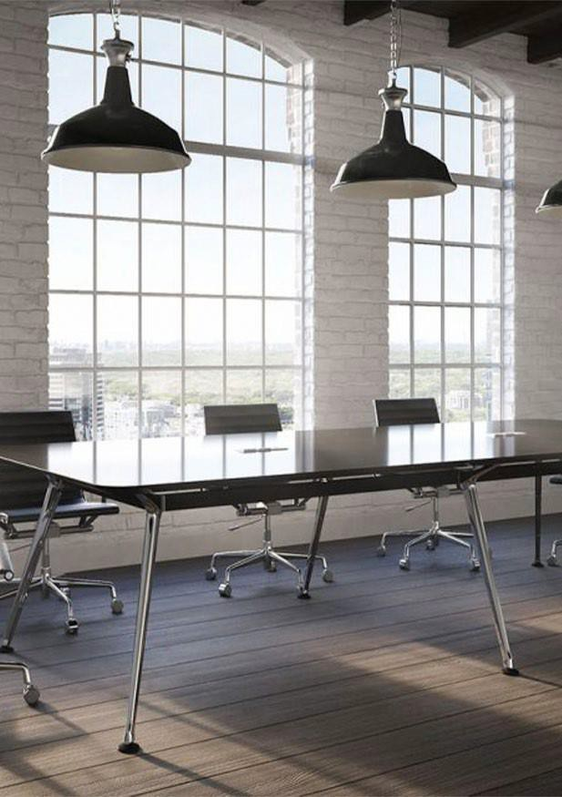
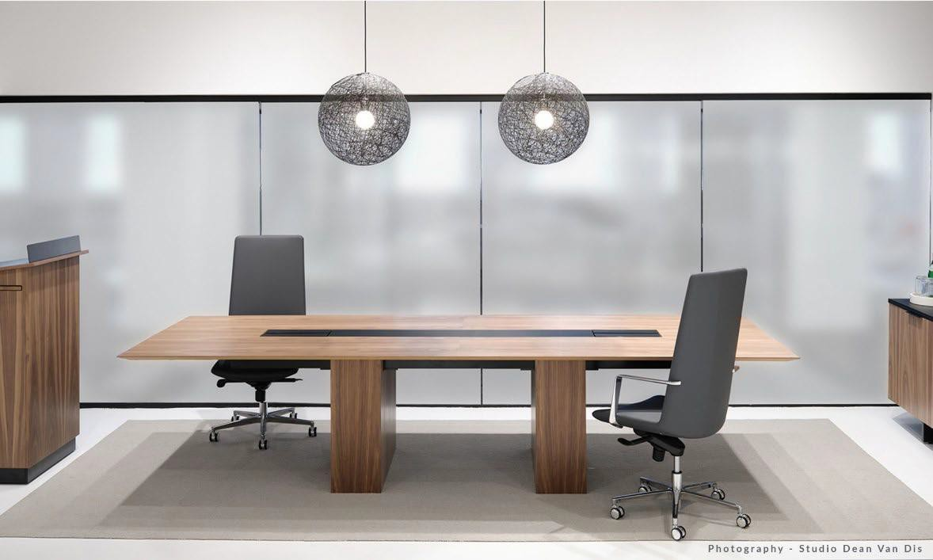
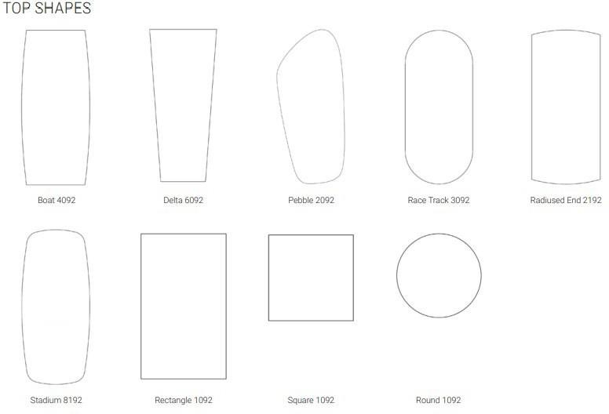
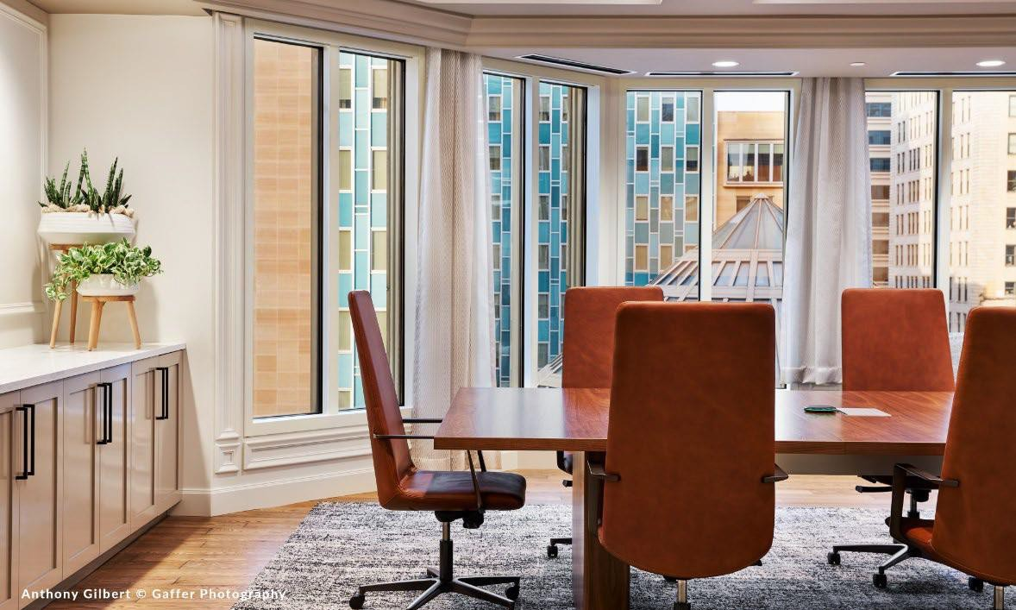
Defign by Source International Design
The “Boardroom”.
Once a place of power, the Boardroom has boldly returned to be gathering place for client facing, and critical business meetings. A bit more formal than huddles, or typically conference rooms. The return to workplace requires a few formal spaces. Today’s Boardroom delivers on that “formal aesthetic” with one key difference: it will uniquely and transparently tell a story about the company’s specific brand, history and culture.

Slide 10
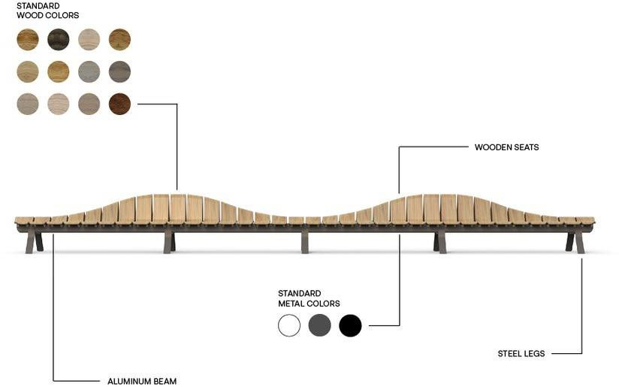
Ascent.
GREEN FURNITURE CONCEPT

Slide 11
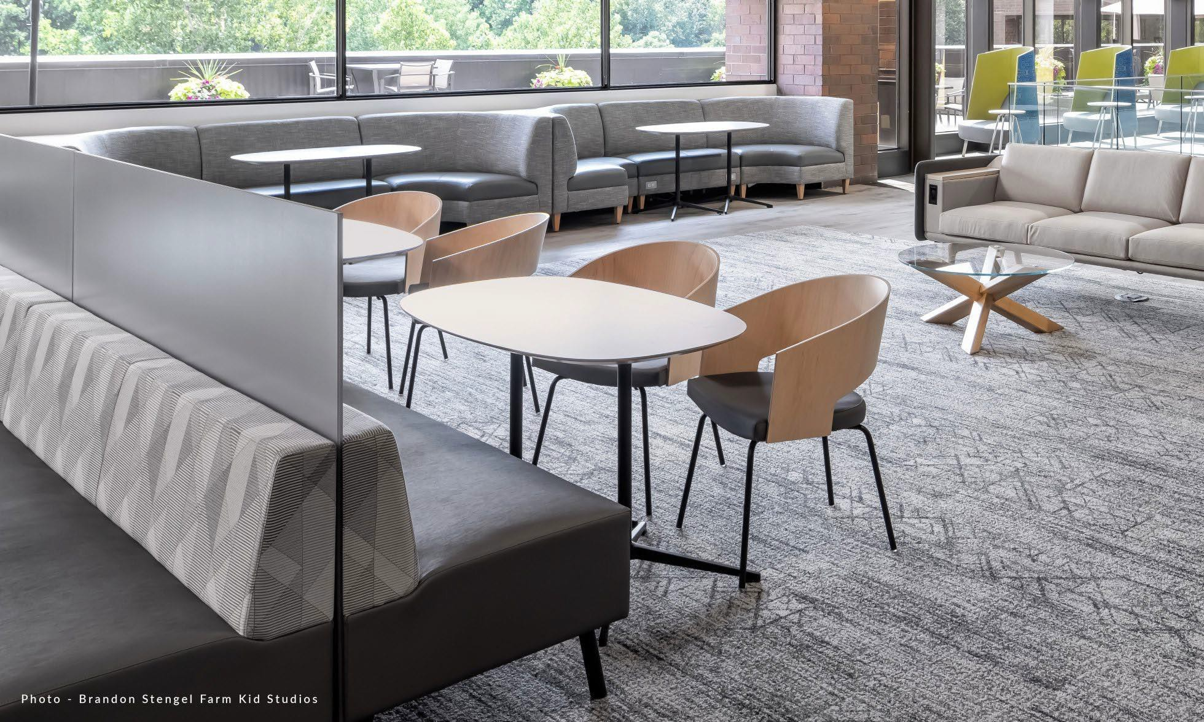
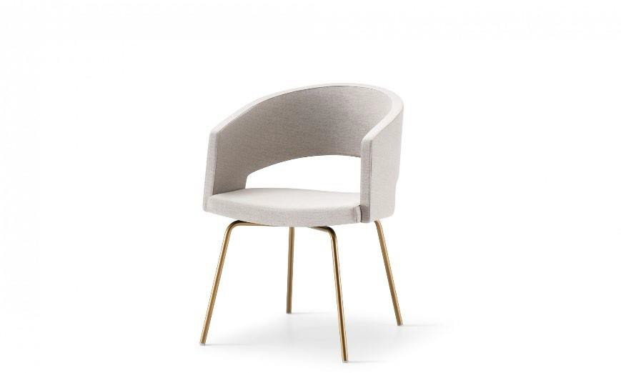
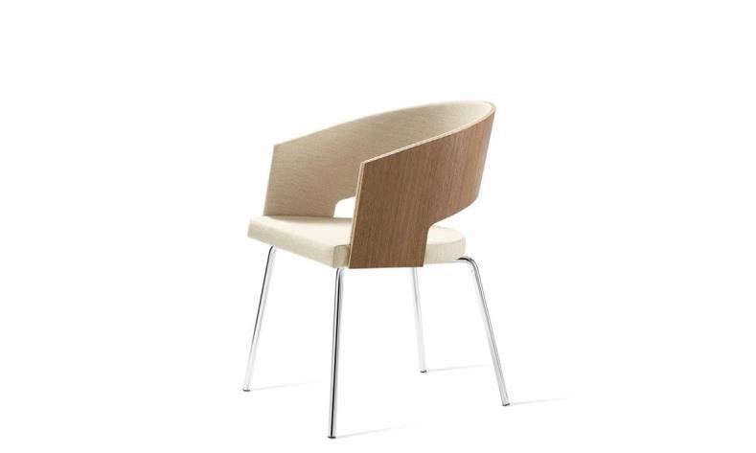
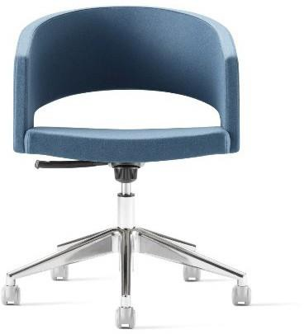
Botte.
Designed by Joachim Jensen, the Botte side chair celebrates longevity in the Source International Design offering due to is classic styling and comfortable sit.
Available in 5 of our premium veneers and 7 metal
finishes. Whether conference, or collaboration this is a great fit.
Spotlight on a local installation.

Slide 12
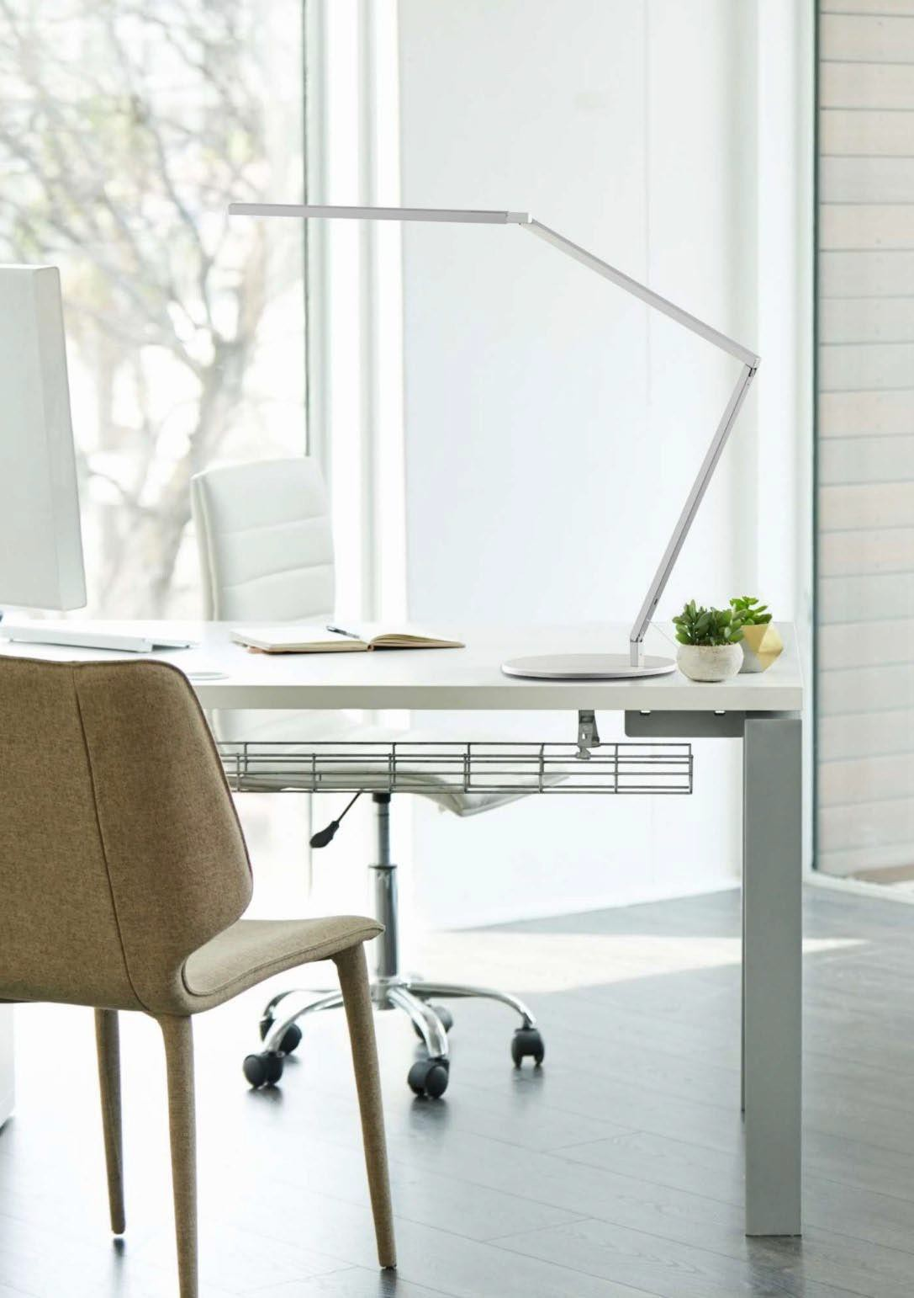
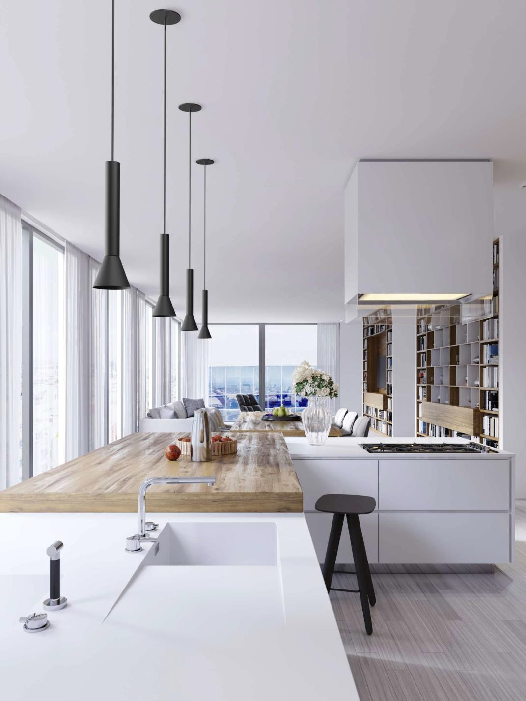
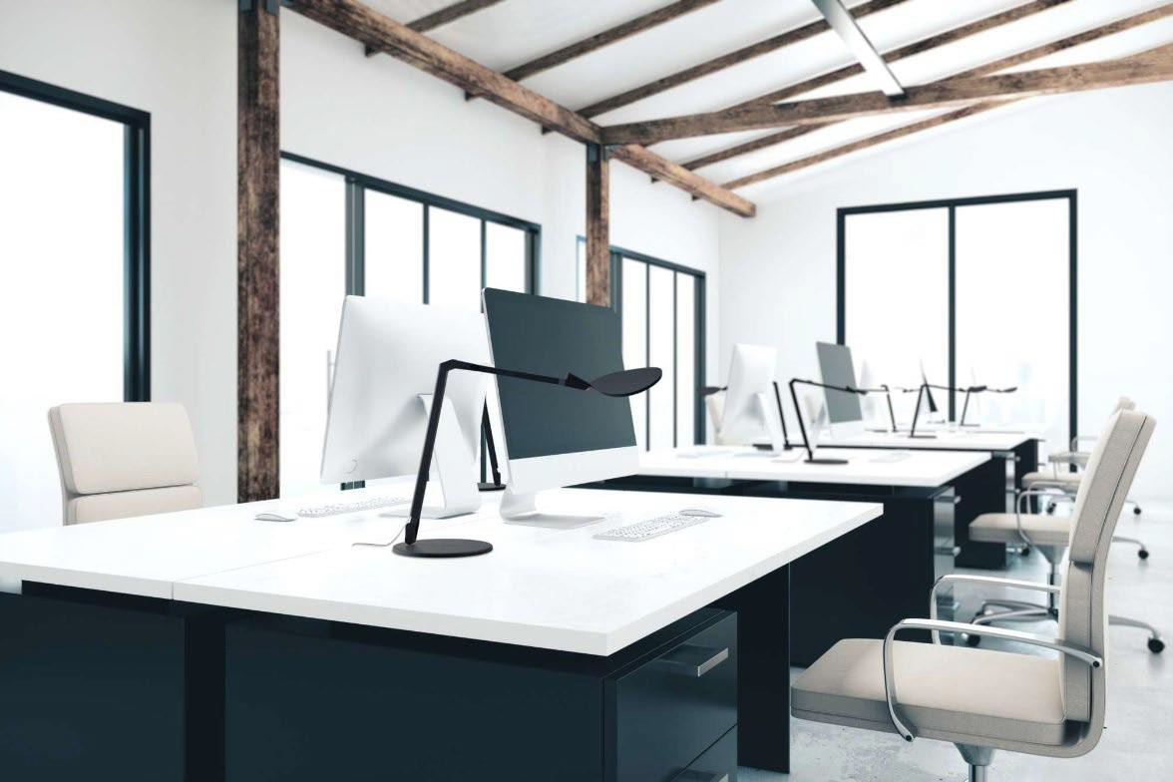
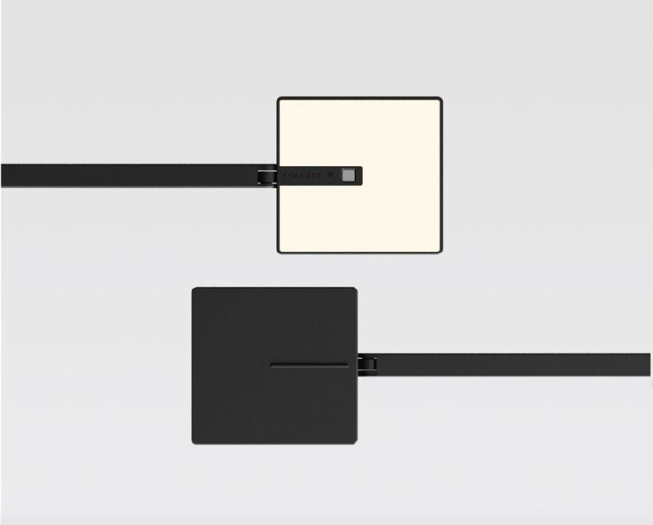
Koncep t Lighting
Award Winners.

Slide 13
Our Lines
Markets servered: Hospitality, Healthcare, Higher Ed, Senior L i v ing and Workplace.
HAT Collective
Ergonomic specialists. Height adjustable tables, monitor arms, power beam and accessories. Quick Ship available. On CET.
Source Intl Design
Scandinavian Design, made in the US. High Design Responsible pricing. For today’s workplace, social spaces, higher ed and healthcare. Quick Ship available. On CET.
Green Furniture Concept
Swedish Manufacture, biophilic furniture and lighting. Great for public spaces in hospitality, healthcare and workplace.
BRC Group
Canada based manufacture of laminate casegoods, lockers and tables.
Coriander Designs
Veneer, stone or quartz tables, wood enhanced seating and benches. Based in Woodinville WA. Women owned.
Koncept Lighting
LED Lighting manufacture. Desk lighting,
wall sconces, under-cabinet and pendants
Meyer Wells
Modern solid wood furniture shoppe. Philosophy Art is Wood. Perfect for Hospitality, and Workplace. Hand crafted.
Ultrafabrics
Textile color experts, performance fabric Mill. Patented Takumi Technology for the best comfort and longevity.

Slide 14
New Pocket Cable manager from
HAT Collective
Erin Eneboe.
eeneboe@etuinteriors.com
@etuinteriors
Connect.
5780 Lincoln Dr,
Suite 305
Edina, MN 55436
612-251-8867

